Slide 1
Day 6 – Microservices Training
Nikhil Damle
Amar Durga Tatyasaheb Patil
November – December 2021

Slide 2
Microservices Testing
Test-driven development (TDD)
Microservices Testing with TDD
Testing scenarios and strategy
Testing Best Practice for Microservices
The Principles of Microservice Monitoring
Logging & Auditing
Actuator Demo

Slide 3
Test-Driven Development (TDD)
Test-driven development or TDD is a development philosophy that emphasizes very short development cycles. With TDD, development teams chart out their business requirements, and outline specific behavioural use cases to verify.
TDD for APIs has become a common practice, however, how do we perform efficient TDD with limited resources upon an entire microservice ecosystem? Within this article, we’ll demonstrate a case study in establishing a reusable testing methodology for a microservice platform.
We’ll also identity different test types like platform testing, integration tests, functional testing, and unit testing.

Slide 4
Why TDD?
A significant advantage of TDD is that it enables you to take small steps when writing software. This is a practice that I have promoted for years because it is far more productive than attempting to code in large steps. For example, assume you add some new functional code, compile, and test it. Chances are pretty good that your tests will be broken by defects that exist in the new code. It is much easier to find, and then fix, those defects if you've written two new lines of code than two thousand. The implication is that the faster your compiler and regression test suite, the more attractive it is to proceed in smaller and smaller steps. I generally prefer to add a few new lines of functional code, typically less than ten, before I recompile and rerun my tests.
I think Bob Martin says it well “The act of writing a unit test is more an act of design than of verification. It is also more an act of documentation than of verification. The act of writing a unit test closes a remarkable number of feedback loops, the least of which is the one pertaining to verification of function”.
The first reaction that many people have to agile techniques is that they're ok for small projects, perhaps involving a handful of people for several months, but that they wouldn't work for "real" projects that are much larger.

Slide 5
What is BDD?
Behaviour-driven development typically involves a developer, test engineer and a product manager (and potentially other stakeholders). The group meets to come up with concrete examples of acceptance criteria in a user story. These examples are described using a domain-specific language, like Gherkin, and put into a feature file. The feature file is converted into an executable specification where developers can then write an actual executable test.
For example, a feature file in Cucumber might describe a user sign in process:
Scenario: User can sign in
Given a valid user with username “abc"
When I login as “abc"
Then I should see a message "Welcome, abc"

Slide 6
Microservices Testing with TDD
Using TDD for web development, specifically with microservices and APIs, means iterative testing of specific behaviours. This could involve iterative testing of API calls in a separate project for API tests, fixing failures, and coding new functionalities into a system.
Software is either developed or improved to pass these use cases, and this process is repeated to introduce successive behaviours.
Steve Klabnik’s TDD process for APIs seeks to validate that the API is working as intended. In 2012 he outlined TDD for APIs with the following steps:
1. Write a test for some behaviour you’d like to introduce into your system.
2. Run your test suite, and make sure that test fails.
3. Write the simplest code that implements the behaviour.
4. Run your test suite, and make sure that test passes.
5. Refactor, because the simplest code often has undesirable properties.
6. Commit, and GOTO 1.

Slide 7

What problem are we trying to solve?
Provide a framework for consumers to set expectations using contracts with the producer.
Have the producer own the stub generation based on the consumer contracts to maintain consistency.
Have the consumer build their application confidently using TDD against the producer validated stubs.
Producer test lifecycle includes validating consumer contracts.
Minimize E2E integration tests.

Slide 8
Testing Scenarios and Strategy
What is a Test Scenario?
A TEST SCENARIO is defined as any functionality that can be tested. It is also called Test Condition or Test Possibility. As a tester, you should put yourself in the end user’s shoes and figure out the real-world scenarios and use cases of the Application Under Test.
Why create Test Scenarios?
Test Scenarios are created for the following reasons,
Creating Test Scenarios ensures complete Test Coverage
Test Scenarios can be approved by various stakeholders like Business Analyst, Developers, Customers to ensure the Application Under Test is thoroughly tested. It ensures that the software is working for the most common use cases.
They serve as a quick tool to determine the testing work effort and accordingly create a proposal for the client or organize the workforce.
They help determine the most important end-to-end transactions or the real use of the software applications.
For studying the end-to-end functioning of the program, Test Scenario is critical.

Slide 9
Test Strategy
Test Strategy is a set of guidelines that explain the test design and determine how testing needs to be done.
Example: A Test Strategy includes details like “Individual modules are to be tested by the test team members”. In this case, who tests it does not matter – so it’s generic and the change in the team member does not have to be updated, keeping it static.
Test Strategy Document
The purpose of the test strategy is to define the testing approach, the types of tests, test environments, and tools to be used for testing and the high-level details of how the test strategy will be aligned with other processes. The test strategy document is intended to be a living document and will be updated** when we get more clarity on Requirements, SLA parameters, Test environment and Build management approach, etc.
Test strategy is intended for the complete project team that comprises of Project Sponsors, Business SMEs, Application/ Integration Development, System Integration partners, Data Conversion Teams, Build/Release Management Teams such as technical leads, architecture leads, and deployment and infrastructure teams.

Slide 10
Test Strategy – Steps
Below are the important steps that a test strategy document should have: Project Overview
What was the need for the project?
What objectives the project will attain?
Requirements Scope
Requirement scope can include Application Scope and Functional scope
Application Scope defines the system under test and the impact on the system due to new or changed functionality. Related systems can also be defined.
Functional Scope defines the impact on different modules within the system. Here each related system with respect to functionality will be explained.
High-Level Test Plan
Test Plan is a separate document. In the test strategy, a high-level test plan can be included. A high-level test plan can include test objectives and test scope. Test scope should define both in scope and out of scope activities.

Slide 11
Steps continued…
Test Approach
Test Schedule: Explain the proposed project timeline in this subsection
Functional Testing Approach: Using this subsection provides an overview of each phase and the respective entry and exit criteria. Different testing phases are Unit testing, System testing, System Integration testing, User Acceptance Testing, and End-to-End testing.
Test Coverage
This section describes the processes that the QA team will follow in order to optimize the coverage of business/functional requirements in test scenarios and test cases. Requirement Traceability Matrix: (RTM) can be used to trace all the requirements with respective test scenarios and test cases.
Test Environment
Define the different QA environments available. Mention what testing will be done in which environment and by whom. Create an environment backup plan to take care of emergencies. Access to each environment should be regulated and called out with clarity.

Slide 12
Steps continued…
QA Deliverables and Metrics
Test Strategy Document
Requirement Traceability Matrix
ST Test Scripts
Test Summary Report
Automation eligible scenario list
Defect Management
Clearly define a defect management strategy by creating a defect workflow, defect tracking methodology & defect triage process. Mention defect responsibility for each tester’s roles. Periodic defect analysis and root cause analysis will improve the overall quality of testing
Communication Management
Set guidelines for status reports, status meetings, and onsite-offshore communication.
Assumptions, Risks, and Dependencies
Describe assumptions on which the project is based. These may include timing, resources, and system capabilities. Describe any dependencies such as other projects, availability of temporary resources, other deadlines that may impact the project

Slide 13
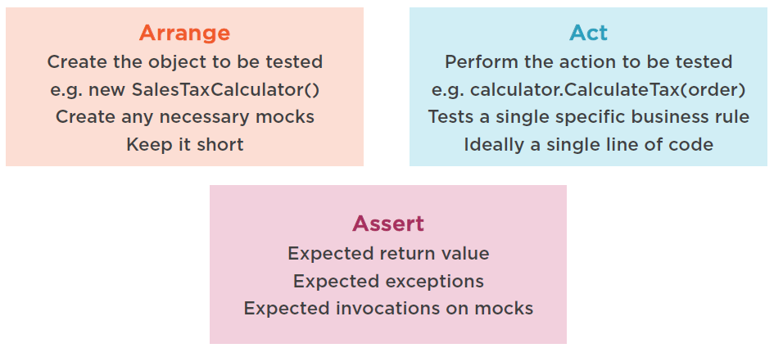
Arrange, Act, Assert

Slide 14
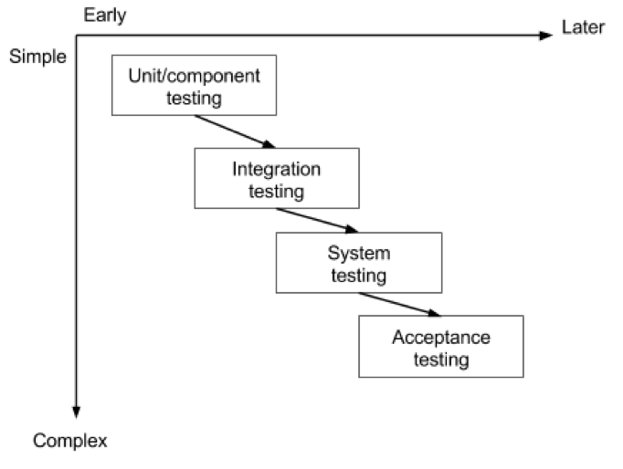
The Testing Sequence
There is a logical sequence that should be adhered to in order to minimise the risk of bugs cropping up just before the launch date.

Slide 15
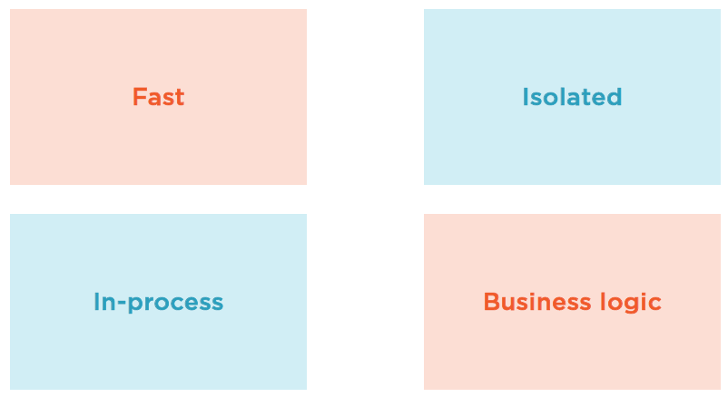
Unit/Component Testing
The most basic type of testing is unit, or component, testing.
Unit testing aims to verify each part of the software by isolating it and then perform tests to demonstrate that each individual component is correct in terms of fulfilling requirements and the desired functionality.
This type of testing is performed at the earliest stages of the development process, and in many cases it is executed by the developers themselves before handing the software over to the testing team.
The advantage of detecting any errors in the software early in the day is that by doing so the team minimises software development risks, as well as time and money wasted in having to go back and undo fundamental problems in the program once it is nearly completed.

Slide 16
Integration Testing
Integration testing aims to test different parts of the system in combination in order to assess if they work correctly together. By testing the units in groups, any faults in the way they interact together can be identified.
There are many ways to test how different components of the system function at their interface; testers can adopt either a bottom-up or a top-down integration method.
In bottom-up integration testing, testing builds on the results of unit testing by testing higher-level combination of units (called modules) in successively more complex scenarios.
It is recommended that testers start with this approach first, before applying the top-down approach which tests higher-level modules first and studies simpler ones later.
System Testing
The next level of testing is system testing. As the name implies, all the components of the software are tested as a whole in order to ensure that the overall product meets the requirements specified.
System testing is a very important step as the software is almost ready to ship and it can be tested in an environment which is very close to that which the user will experience once it is deployed.
System testing enables testers to ensure that the product meets business requirements, as well as determine that it runs smoothly within its operating environment. This type of testing is typically performed by a specialized testing team.

Slide 17
Acceptance Testing
Finally, acceptance testing is the level in the software testing process where a product is given the green light or not. The aim of this type of testing is to evaluate whether the system complies with the end-user requirements and if it is ready for deployment.
The testing team will utilise a variety of methods, such as pre-written scenarios and test cases to test the software and use the results obtained from these tools to find ways in which the system can be improved.
The scope of acceptance testing ranges from simply finding spelling mistakes and cosmetic errors, to uncovering bugs that could cause a major error in the application.
By performing acceptance tests, the testing team can find out how the product will perform when it is installed on the user’s system. There are also various legal and contractual reasons why acceptance testing has to be carried out.

Slide 18
Testing Best Practice for Microservices
The application stack has undergone fundamental changes with the advent of microservices architecture, and this has had a ripple effect on software testing. For a monolithic application released every quarter, testing was reserved for the very last week or two before release. Today, with micro-releases happening multiple times daily, software testing is more granular, it happens simultaneously with development, and it is fundamentally different from testing for a monolithic application.
3 Best Practices for Testing Microservices
Unit tests and microservices
Testing integration between services
Plan to fail small

Slide 19

Docker
Docker makes development efficient and predictable
It takes away repetitive, mundane configuration tasks and is used throughout the development lifecycle for fast, easy and portable application development - desktop and cloud
It is a set of platform as a service (PaaS) products that use OS-level virtualization to deliver software in packages called containers.
Containers are isolated from one another and bundle their own software, libraries and configuration files; they can communicate with each other through well-defined channels.
Because all of the containers share the services of a single operating system kernel, they use fewer resources than virtual machines.
Docker Hub - https://hub.docker.com/

Slide 20
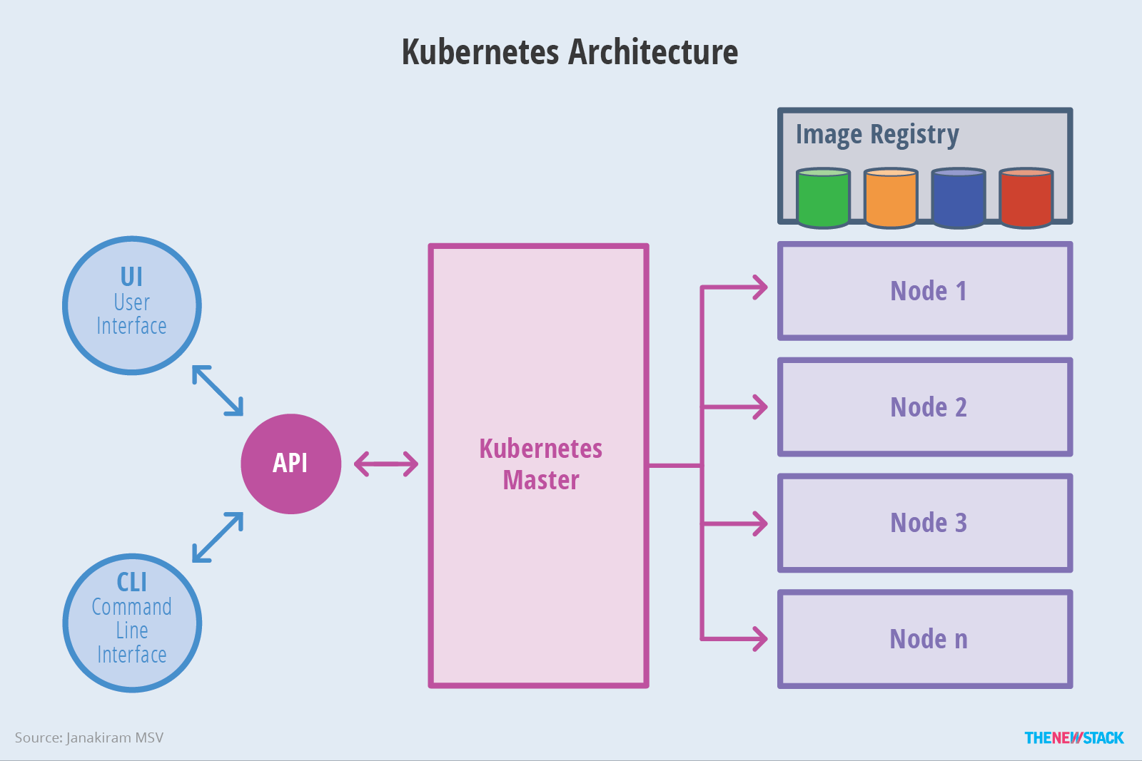
Kubernetes

Slide 21
Kubernetes
A Kubernetes cluster consists of one master and multiple compute nodes.
The master is responsible for exposing the application program interface (API), scheduling the deployments and managing the overall cluster.
Each node runs a container runtime, such as Docker , along with an agent that communicates with the master.
A pod is a collection of one or more containers.
Pod always runs on a Node. A Node is a worker machine in Kubernetes and may be either a virtual or a physical machine, depending on the cluster.

Slide 22

Microservices Monitoring
Why should systems be monitored?
What data should be gathered when monitoring?
What tools are available for publishing, gathering and storing monitoring data?

Slide 23
Why Monitor Your Microservices?
Monitoring is a process of reporting, gathering and storing data. Applications developed using microservice architecture need to be monitored for the same reasons as any other type of distributed system: that is, all systems eventually fail.
Monitoring systems over time produces valuable data that can be used to improve service performance.
Failure and performance data can be analysed to look for patterns in system failures, which can be correlated with events.
For example, consider a case where data indicates 25 percent of total system failures occur within an hour of a new deployment. This would thus be a strong indicator that deployment processes need attention and improvement.

Slide 24
Monitoring Microservices: What to Measure
Monitoring is a process of reporting, gathering and storing data. The first question to ask is, which data are useful. Large distributed systems process huge amounts of data every day, potentially generating gigabytes of new metadata about their behaviour in a short time.
How does one find the signal amid the noise? Each application will have unique needs relating to monitoring. There are a few common metrics you’ll want to record.
- Decide What is important
- Be selective
Metrics Categories:
Application Metrics
Platform Metrics
System Events

Slide 25
Application Metrics
These metrics relate specifically to your application.
Request per second
Latency
Request Duration
If your application accepts user registrations, a standard metric might be how many were successfully completed in the last hour.
A tax-preparation system might record context-specific events such as form validation.
These top-level data are useful for development teams and the organization to understand the functional behaviour of the system.
If peak-volume form validation typically occurs 1,000 times an hour, and suddenly that throughput drops to 500 over the last two hours, that anomaly could be an indication of a problem.

Slide 26
Platform Metrics
These metrics report on the nuts and bolts of your infrastructure.
CPU count
Memory usage
Network latency
Database query execution time
Examples include:
The overall average execution time of each of the top ten most frequently executed database queries;
The average execution time of the fastest 10 percent;
The average execution time of the slowest 10 percent;
The number of requests per minute a service receives;
The average response time for each service endpoint;
The success/failure ratio for each service.

Slide 27
System Events
Record:
Deployments
Infrastructure changes
Anu other System Events

Slide 28
Monitoring Tools
Raygun APM: Raygun’s APM platform is another example of a complete system that provides both instrumentation and collector processes, as well as a dashboard to visualize metrics data. Raygun APM supports .NET, Java and Ruby support are in development.
Zipkin: Zipkin is an open-source tracing system designed specifically to trace calls between microservices. It is especially useful for analysing latency problems. Zipkin includes both instrumentation libraries and the collector processes that gather and store tracing data.
Apache Kafka: Kafka is a streams-processing system. It uses a “publish/subscribe” methodology for reading and writing data to a logical “stream,” which is similar in concept to a messaging system such as RabbitMQ. Kafka can be combined with other tools such as Zipkin to provide a robust solution for transmitting and storing metrics data.
Grafana: The data gathered by all these tools isn’t very useful unless it can be interpreted and analysed. To this end, Grafana is a web-based visualization tool that is used to build visual dashboards.

Slide 29
Principles of Microservice Monitoring
Monitor containers and what’s inside them
Alert on service performance, not container performance.
Monitor services that are elastic and multi-location.
Monitor APIs.
Map your monitoring to your organizational structure.

Slide 30
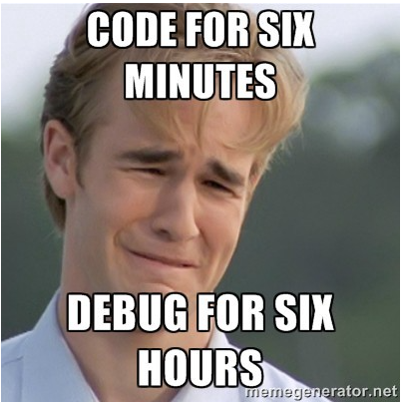
Logging
Have you ever taken 6 hours for debugging while only 6 minutes for coding in order to resolve a bug?

Slide 31

Logging
In a beautiful day, you go to the office, open your laptop, the first thing caught your eye is there are a dozen complaining emails from the customer that related to a broken feature last night. You test that function again, it works well! So, what was exactly going on with the system last night while you were sleeping?

Slide 32
Logging
As a developer or administrator, if you want to troubleshoot any issue, that leaves you clueless. You don’t know which microservice running on which host served your request.
If your environment is auto-scaled, then troubleshooting an issue is unimaginable.
A good/meaningful logging system is a system that everyone can use and understand. Don’t think that only developers need logging.
Bear in mind that, logging system is not only for developers. It’s also used by others (system admin, tester…) So, you should consider logging data that everyone can use and understand.

Slide 33
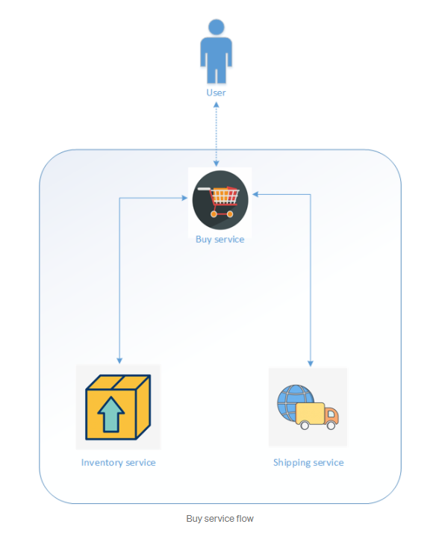
Logging
Use a Unique Id to correlate Requests
In MSA, services interact with each other through an HTTP endpoint. End users only know about API Contract (Request/Response), and don’t know how exactly do services work.

Slide 34
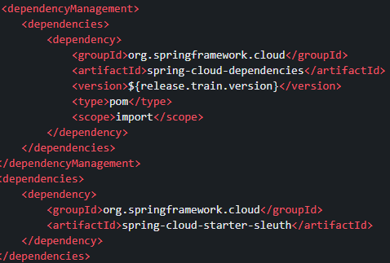
Generate a correlation ID when you are making the first microservice call and pass that same ID to downstream services. Log the correlation ID across all microservice calls. That way, we can use the correlation ID coming from the response to trace out the logs.
If you are using Spring Cloud to develop microservices, you can use the Spring Sleuth module along with Zipkin.

Slide 35
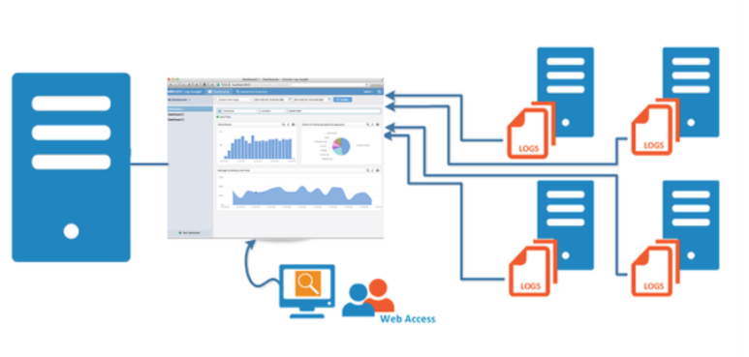
2. Centralize and Externalize Log Storage
As microservices are running on multiple hosts, you should send all the generated logs across the hosts to an external, centralized place. From there, you can easily get the log information from one place. It might be another physical system that is highly available or an S3 bucket or any other storage option. If you are hosting your environment on AWS, you can leverage CloudWatch, and other cloud providers generally offer similarly appropriate services.

Slide 36
3. Define the format for logging
Applying MSA allows you to use different technology stacks for each service. For example, you can use .Net Core for Buy service, Java for Shipping service and Python for Inventory service. However, it also impacts to log format of each service.
JSON allows you to have multiple levels for your data so that, when necessary, you can get more semantic info in a single log event.
4. Log useful/meaningful data
When? — Time (with full date format): It doesn’t require using UTC format. But the timezone has to be the same for everyone that needs to look at the logs.
What? — Stack errors: All exception objects should be passed to the logging system.
Where? — Besides service name as we using MSA. We also need function name, class or file name where the error occurred. — Don’t guess anything, it might waste your time.
Who? — The IP address of the client and user name if any. (Make sure don’t use this information to blame your teammates :)

Slide 37
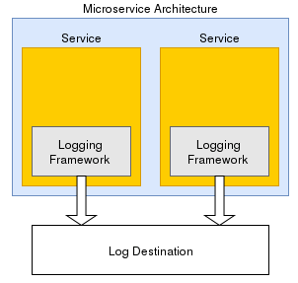
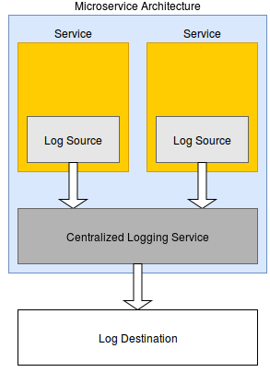
There are two important techniques of logging followed in MSA
Implement Logging in each service.
Implement central Logging service.

Slide 38
Actuator Demo

